Slide 1
Project Costs
Project costs refer to the financial resources required to complete a project, including:
Labor costs
Material costs
Equipment costs
Operational expenses
Contingency reserves
The purpose of project cost management is to ensure that the project is completed within the approved budget, with optimal resource utilization.

Slide 2
Types of Project Costs
Project costs can be classified into several types based on their nature and purpose:
Direct Costs
Costs directly attributable to the project.
Examples:
Salaries of project team members
Materials used in construction
Equipment used on-site
Indirect Costs
Costs that cannot be directly assigned to a specific project activity.
Examples:
Administrative overhead
Utilities
Rent for office space

Slide 3
Types of Project Costs
Fixed Costs
Costs that remain constant throughout the project, regardless of project progress or output.
Examples:
Lease payments
Insurance costs
Variable Costs
Costs that change depending on the volume or scope of the project.
Examples:
Cost of raw materials
Labor costs depending on work hours

Slide 4
Project Cost Management
Project cost management involves processes required to plan, estimate, budget, finance, manage, and control project costs. The goal is to ensure the project is completed within the approved budget.
Key Components:
Cost estimation
Budgeting
Cost control

Slide 5
Cost Management Processes
Project Cost Management consists of four main processes:
Plan Cost Management
Defining how to manage and control project costs, including how cost estimates will be developed, how budgets will be established, and how performance will be measured.
Outputs:
Cost Management Plan
Estimate Costs
Developing an approximation of the costs of resources needed to complete project activities.
Outputs:
Cost Estimates
Basis of Estimates

Slide 6
Cost Management Processes
Determine Budget
Aggregating the cost estimates to establish an authorized cost baseline.
Outputs:
Project Budget
Cost Baseline
Control Costs
Monitoring project cost performance, identifying any variances from the cost baseline, and taking corrective actions as necessary.
Outputs:
Work Performance Information
Cost Forecasts

Slide 7
Project Cost Estimation
Cost estimation is the process of approximating the monetary resources required to complete project activities. It helps the project manager to plan and budget the project.
Types of Cost Estimation
Analogous Estimating (Top-Down)
Definition: Using historical data from similar projects to estimate the cost of the current project.
Advantages: Quick, low effort
Disadvantages: Less accurate, depends on the availability of past data
Example: Estimating the cost of building a house based on the cost of previous house projects.
Parametric Estimating
Definition: Uses a statistical relationship between historical data and other variables (e.g., cost per square foot).
Example: Cost of construction per square foot in a particular city.

Slide 8
Project Cost Estimation
Bottom-Up Estimating
Definition: Estimating the cost of each individual project activity and then summing them to get the total cost.
Advantages: More accurate
Disadvantages: Time-consuming
Example: Estimating the cost of materials, labor, and equipment for each activity in a construction project.
Three-Point Estimating
Definition: Uses three estimates for each activity: optimistic, pessimistic, and most likely.
Formula:
E = (O + 4M + P) / 6
Where:
E = Expected cost
O = Optimistic cost
M = Most likely cost
P = Pessimistic cost
Example: Estimating the cost of software development where O = $10,000, M = $12,000, P = $14,000.
E = (10,000 + 4*12,000 + 14,000) / 6 = $12,000

Slide 9
Review of Cost Estimation and Its Types
Cost estimation is crucial for planning and monitoring the financial health of the project. Understanding the accuracy and level of detail required for different types of estimates is essential.
Analogous Estimating: Quick but less precise.
Parametric Estimating: More accurate, especially for large projects.
Bottom-Up Estimating: Very detailed and accurate but time-consuming.
Three-Point Estimating: Provides a more balanced view by considering different possible scenarios.

Slide 10
Bottom-Up vs Top-Down Approach
Bottom-Up Estimating
Estimating the cost of individual activities and summing them to obtain the total project cost.
Advantages: Highly accurate
Disadvantages: Time-consuming and requires detailed information
Example: Estimating the costs of each task in a construction project (materials, labor, overhead) and adding them up.
Top-Down Estimating
Using overall project data from similar projects to estimate costs for the current project.
Advantages: Quick and cost-effective
Disadvantages: Less accurate
Example: Estimating the cost of a new IT project based on the cost of similar IT projects.

Slide 11
Expert Judgment
Expert judgment involves relying on the knowledge and experience of experts to help estimate costs, identify risks, and suggest strategies. This is commonly used in all phases of project cost management.
Example:
A senior project manager with experience in software projects is asked to estimate the time and cost required for a new system, based on his previous work on similar systems.

Slide 12
T-shirt Sizing
T-shirt sizing is a relative estimation technique where project tasks or activities are assigned sizes like XS, S, M, L, XL, based on their complexity and effort required.
Example:
Small: Simple task, like creating a login page.
Large: Complex task, like integrating payment systems.
Advantages:
Quick and simple
Helps in identifying tasks with high complexity early on
Limitations:
Subjective; no exact numbers, so not suitable for precise budget calculation.

Slide 13
Example
Let's say you’re working on a software development project, and your team needs to estimate the effort for several user stories. Instead of estimating in hours or days, you use T-shirt sizes to compare their complexity relative to each other.
User Story 1: Implement Login Functionality
T-shirt Size: M (Medium)
Reasoning: This involves a standard implementation, including user authentication, password handling, and basic UI. It’s a moderate amount of work but well-understood.
User Story 2: Create User Profile Page
T-shirt Size: L (Large)
Reasoning: It’s a bit more complex as it requires integrating data from the backend, handling user input, and possibly adding a photo upload feature. The UI design could be more complicated too.
User Story 3: Integrate with Payment Gateway
T-shirt Size: XL (Extra Large)
Reasoning: This requires working with external APIs, handling sensitive information securely, and thorough testing. It’s a much more complex task than the others.
User Story 4: Update UI for Dashboard
T-shirt Size: S (Small)
Reasoning: Minor updates to the UI, such as changing the color scheme or rearranging elements. It’s a small effort in terms of development time.
User Story 5: Add Multi-Language Support
T-shirt Size: L (Large)
Reasoning: This involves both backend and frontend changes, translating content, ensuring that the app works in different languages, and testing the localization. It’s not as big as the payment gateway integration but still significant.

Slide 14
Story Point Estimation
Story point estimation is used in Agile projects. It assigns a numerical value to a user story or task based on its complexity, rather than its exact time or cost. Story size estimation is a key part of Agile project management where teams estimate the effort or complexity of a user story, typically using Story Points. Unlike T-shirt sizing (which is more about relative size), Story Points are a more granular way to measure effort based on complexity, time, or work required.
In Agile, this is usually done using techniques like Planning Poker, where each team member independently estimates a user story, and then they discuss and converge on a final estimate.
The most common story point scales are:
1: Very small effort (often a task that can be completed in a couple of hours)
2-3: Small but slightly more complex (a few hours to a day of work)
5-8: Medium effort (could take 1-2 days, involves more detailed work)
13-20: Large effort (a few days to a week of work, often involves multiple people or departments)
40+: Extra large (could be weeks of work or requires a lot of coordination)
Example:
A simple task might be given 3 story points.
A more complex task might be given 8 story points.
A very complex task might be assigned 13 story points.
Advantages:
Focuses on relative effort rather than absolute time
Facilitates team collaboration and discussion

Slide 15
Example
Example: Story Size Estimation in an IT Project
Let's say you're working on an e-commerce website and need to estimate several user stories. The stories have different levels of complexity, and the team needs to assign story points to help gauge the overall effort needed for the sprint.
1. User Story: "As a user, I want to be able to register for an account so I can save my cart and preferences."
Story Points: 5
Reasoning: This is a straightforward feature, but it involves both front-end (UI) and back-end (user management) work. It may require some integration with a database and testing, but it's a common and fairly simple task for the team.
2. User Story: "As a user, I want to be able to filter products by category, price range, and rating."
Story Points: 8
Reasoning: This involves creating multiple filters and ensuring they work with the database. There's complexity in terms of handling different types of filters, making sure the UI is responsive, and ensuring performance with large datasets. The user experience also needs to be tested across devices.
3. User Story: "As an admin, I want to be able to view reports of all user activity on the platform, including purchases and login times."
Story Points: 13
Reasoning: This involves not just building a front-end interface for the admin to view the data but also complex back-end work like aggregating and processing user data. You’ll also need to consider security, performance, and integration with existing reporting tools or data pipelines.
4. User Story: "As a user, I want to be able to apply a discount code at checkout."
Story Points: 3
Reasoning: It’s relatively simple in terms of logic (validating the discount code, applying the discount) but still involves both front-end and back-end work. This is a typical functionality in many e-commerce platforms, so it's a bit less complex compared to others.
5. User Story: "As a user, I want to receive an email confirmation after my order has been placed."
Story Points: 2
Reasoning: This is a simple feature that only requires integration with an email service and possibly updating user preferences. The complexity is low, and the task could be completed relatively quickly.

Slide 16
How Estimation Works in Practice
Initial Estimation:
Each story is discussed in the backlog grooming or planning meeting.
The team looks at the requirements and starts to assign story points. In most cases, the first few stories are straightforward.
Estimation with Planning Poker (or other methods):
Each team member has a set of cards with numbers representing story points (often Fibonacci sequence like 1, 2, 3, 5, 8, 13, etc.).
The team discusses the user story and each member privately chooses a card representing their estimate.
Once all cards are shown, if there’s a big discrepancy, the team discusses their reasoning and comes to a consensus.
Relative Estimation:
The estimates are relative — meaning you’re comparing the complexity of a new story with others that have already been estimated.
For example, if a user story feels like it will take "about the same amount of effort" as the "register for account" story, it might get the same number of points.
Review and Adjust:
Over time, you will refine your estimates based on experience. As you progress through sprints, you may adjust the initial story points as you gather more data on how long tasks typically take.

Slide 17
Planning Cost Management
Planning cost management involves defining how project costs will be planned, structured, and controlled. It includes creating the Cost Management Plan, which outlines:
Cost estimating methods
Budgeting process
Cost control procedures

Slide 18
Determining the Budget
Determining the budget is the process of aggregating cost estimates from all project activities and establishing an authorized cost baseline. It includes:
Direct costs
Contingency reserves
Management reserves
Steps:
Develop detailed cost estimates for each activity.
Aggregate the cost estimates.
Add contingency reserves to manage project risk.
Establish the project cost baseline.
Example:
For a software project, after estimating the costs for coding, testing, and deployment, the total cost is $200,000. Adding a contingency reserve of $30,000, the total project budget becomes $230,000.

Slide 19
Cost Control and Measures
Cost control involves monitoring project performance and taking corrective actions to ensure that the project remains within its budget. It includes tracking actual costs, forecasting future costs, and adjusting the budget as necessary.
Common Measures:
Cost Variance (CV):
CV = EV - AC
Where:
EV = Earned Value
AC = Actual Cost
Schedule Variance (SV):
SV = EV - PV
Cost Performance Index (CPI):
CPI = EV / AC
Schedule Performance Index (SPI):
SPI = EV / PV

Slide 20
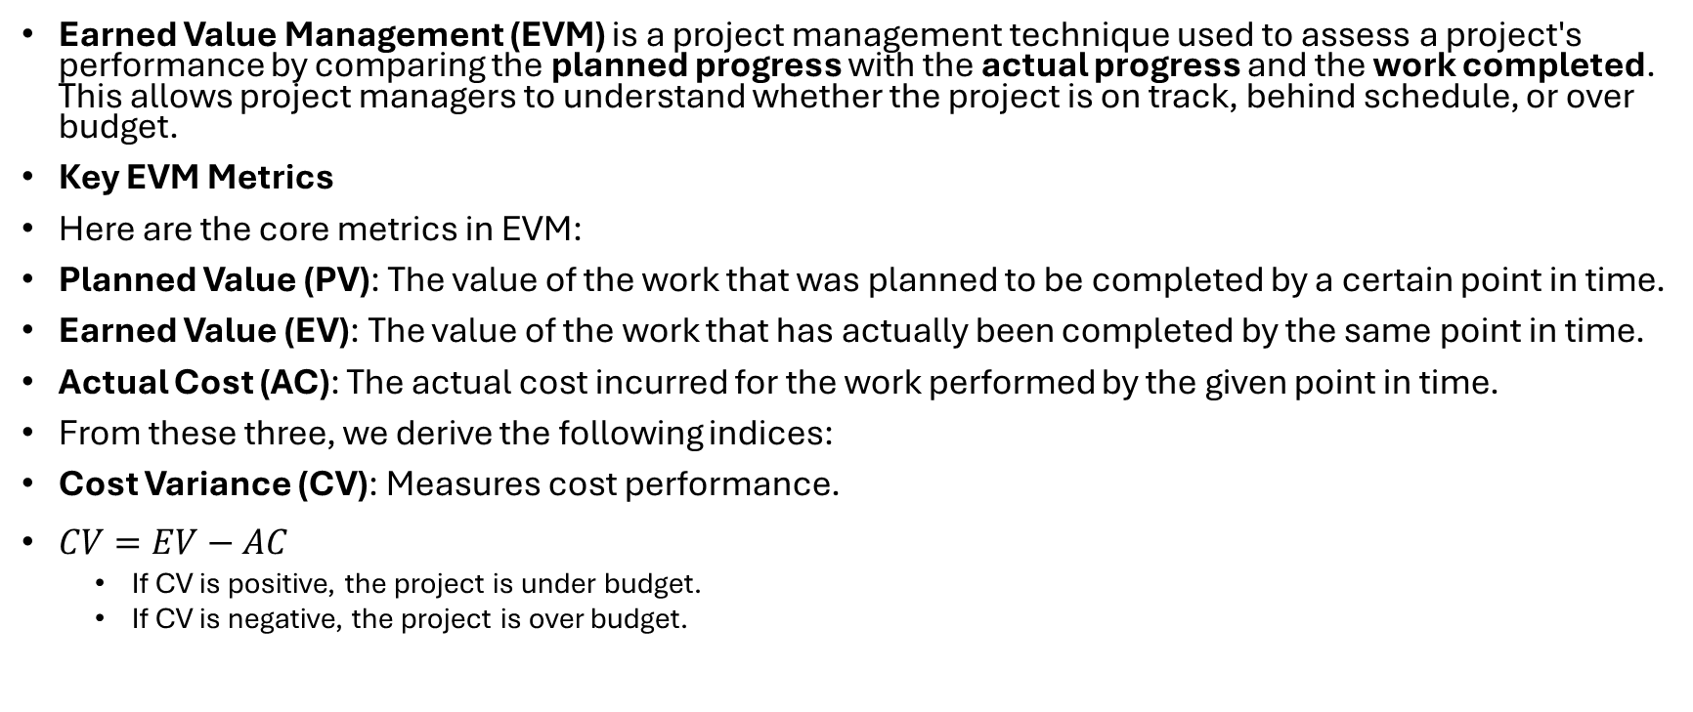
Earned Value Management
Earned Value Management (EVM) is a project management technique used to assess a project's performance by comparing the planned progress with the actual progress and the work completed. This allows project managers to understand whether the project is on track, behind schedule, or over budget.
Key EVM Metrics
Here are the core metrics in EVM:
Planned Value (PV): The value of the work that was planned to be completed by a certain point in time.
Earned Value (EV): The value of the work that has actually been completed by the same point in time.
Actual Cost (AC): The actual cost incurred for the work performed by the given point in time.
From these three, we derive the following indices:
Cost Variance (CV): Measures cost performance.
$CV=EV−AC$
If CV is positive, the project is under budget.
If CV is negative, the project is over budget.

Slide 21
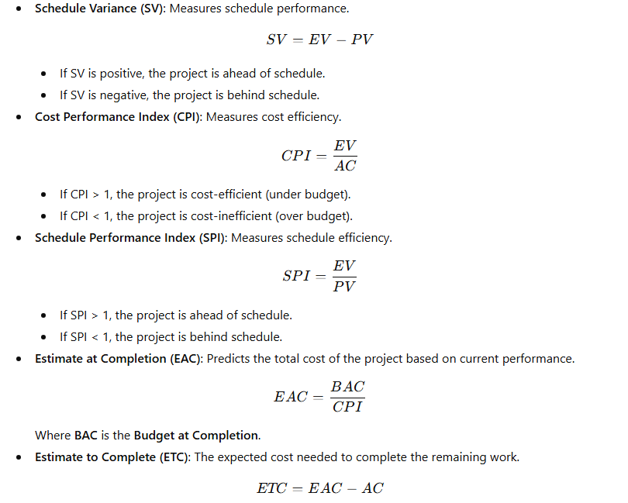
Earned Value Management

Slide 22
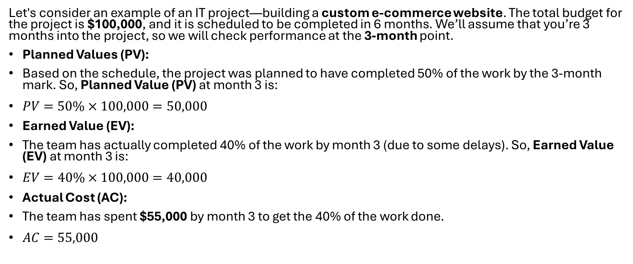
Example
Let's consider an example of an IT project—building a custom e-commerce website. The total budget for the project is $100,000, and it is scheduled to be completed in 6 months. We’ll assume that you’re 3 months into the project, so we will check performance at the 3-month point.
Planned Values (PV):
Based on the schedule, the project was planned to have completed 50% of the work by the 3-month mark. So, Planned Value (PV) at month 3 is:
$PV=50\%×100,000=50,000$
Earned Value (EV):
The team has actually completed 40% of the work by month 3 (due to some delays). So, Earned Value (EV) at month 3 is:
$EV=40\%×100,000=40,000$
Actual Cost (AC):
The team has spent $55,000 by month 3 to get the 40% of the work done.
$AC=55,000$

Slide 23
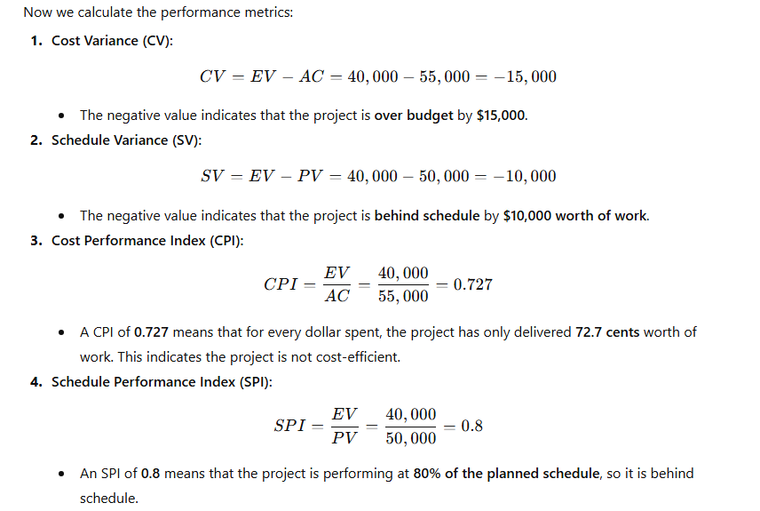
Steps

Slide 24
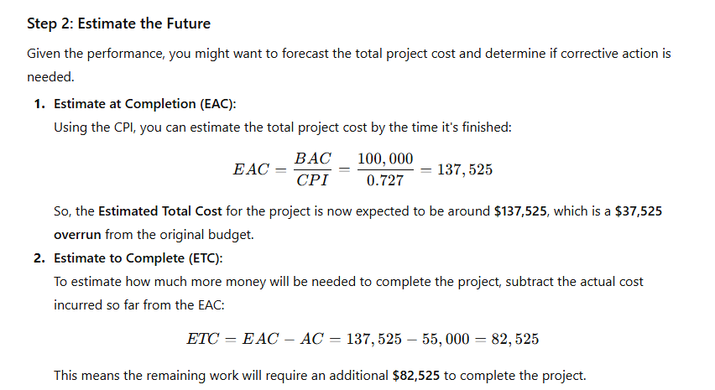
Steps

Slide 25
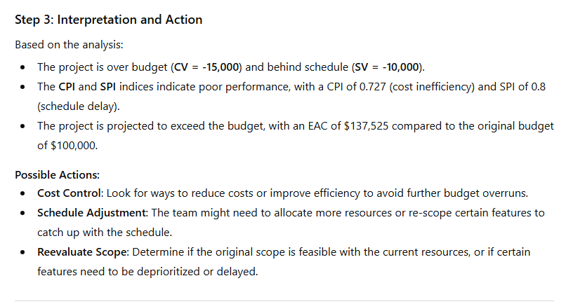
Steps

